Slide 1
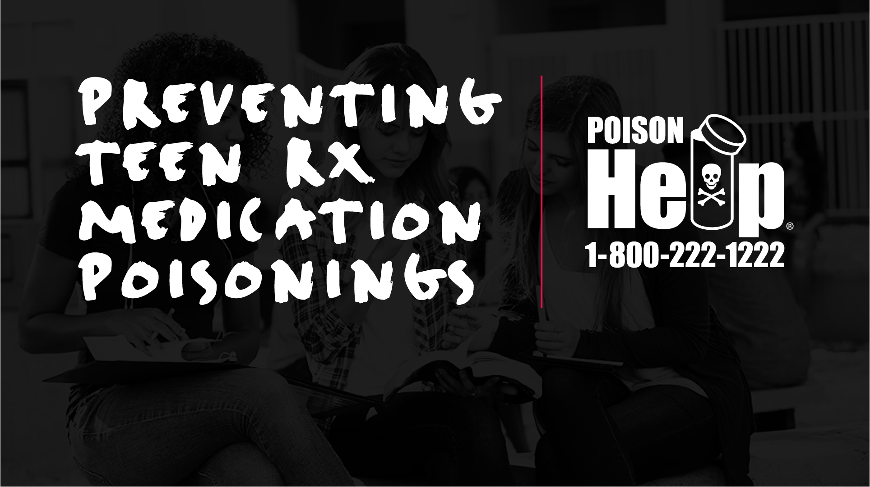
An educational presentation created by NC Poison Control
Notes:
This presentation is about prescription drugs and how to use them safely.
Potential questions to begin discussion:
Do you take prescription medications regularly or know someone who does?
Do you know someone whose life has been impacted by taking prescription drugs (whether positively or negatively)?
Do you would know what to do if someone took to much prescription medication?
Today, we’re going to talk about what healthy prescription drug habits look like and how to avoid a prescription drug poisoning.

Slide 2
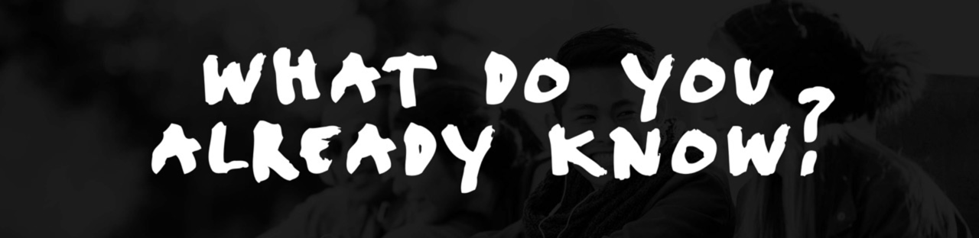
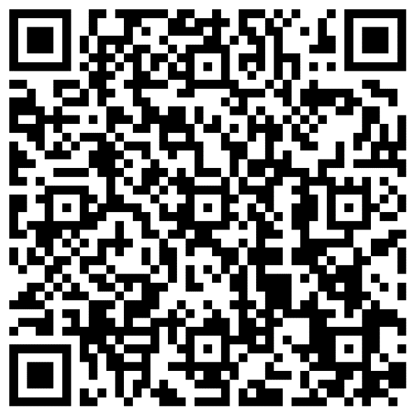
Take Survey
NC Poison Control
Notes:
After scanning the QR code, students will be taken to a 6-question online pre-test that will assess what they currently know about prescription medications.
Pre and post-test responses are available upon request. If you would like the results, please note the date of completion as the survey is anonymous.

Slide 3


How frequently do you think Rx medication poisonings occur among teenagers?
Which prescription drugs cause the
most overdoses?
What should you do if a prescription drug poisoning happens?
What steps can you take to prevent a medication poisoning?
NC Poison Control
Notes:
After reading each question, you may want to leave a brief time for discussion.
Since the questions are intended to encourage class dialogue, it’s ok for students to share answers that may or may not be correct.

Slide 4



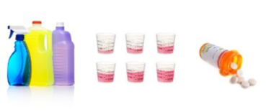
Anything can be a poison, if it’s used in the wrong WAY, by the wrong PERSON,
or in the wrong AMOUNT.
NC Poison Control
Notes:
Yes, medicine can be poisonous. Any substance taken in the wrong way or wrong amount can be poisonous.
The term “poison” simply refers to any substance that can be harmful to your organs or tissues.
Often people aren’t thinking about their medicines as poison because medicines are prescribed by doctors and are widely used. This does NOT mean medicines can’t poison you, however.
The amount of a substance taken can make it poisonous.
Other factors that play a role in determining whether something is poisonous:
a person’s medical history
additional medications/substances taken
type of medicine

Slide 5
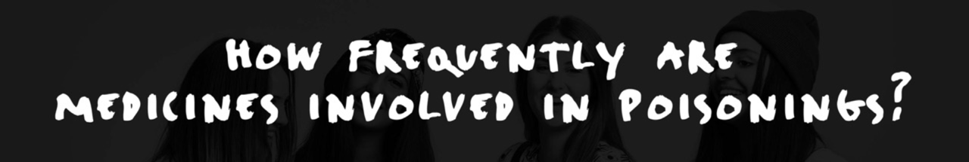
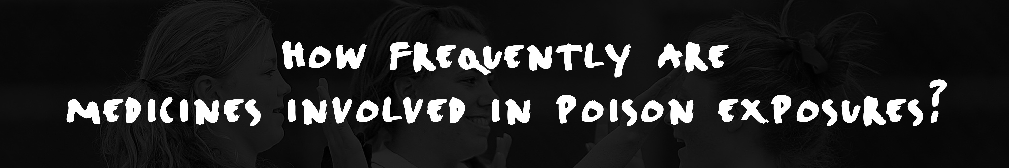
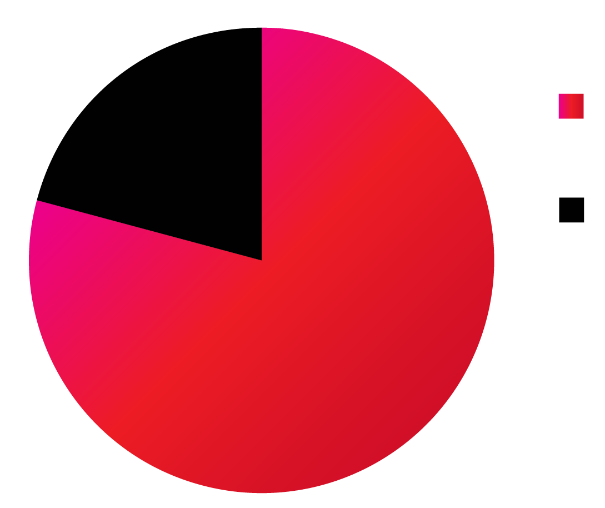
calls about
a medicine/drug
18%
How often is a call to poison control about a medicine or drug?
(calls concerning 13-18 years-old)
calls not about
a medicine/drug
82%
Source: NC Poison Control 2022 data, report run May 16, 2023
NC Poison Control
Notes:
Over 80% of the time, calls and chats to North Carolina Poison Control about teens have to do with a drug (whether prescription, over-the-counter, or illegal).
Here are some of the common types of drugs poison control is contacted about:
Antidepressants (like Prozac® and Zoloft®)
Pain relievers (like OxyContin® and Vicodin®)
Sedatives (like Valium® and Xanax®)
Stimulants (like Adderall® and Ritalin®)
We’ll talk more about these specific types of drugs later in this discussion.

Slide 6
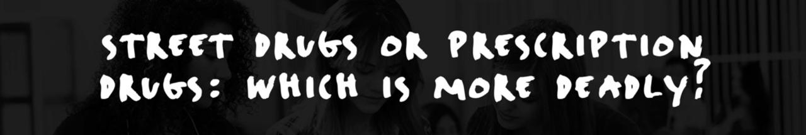
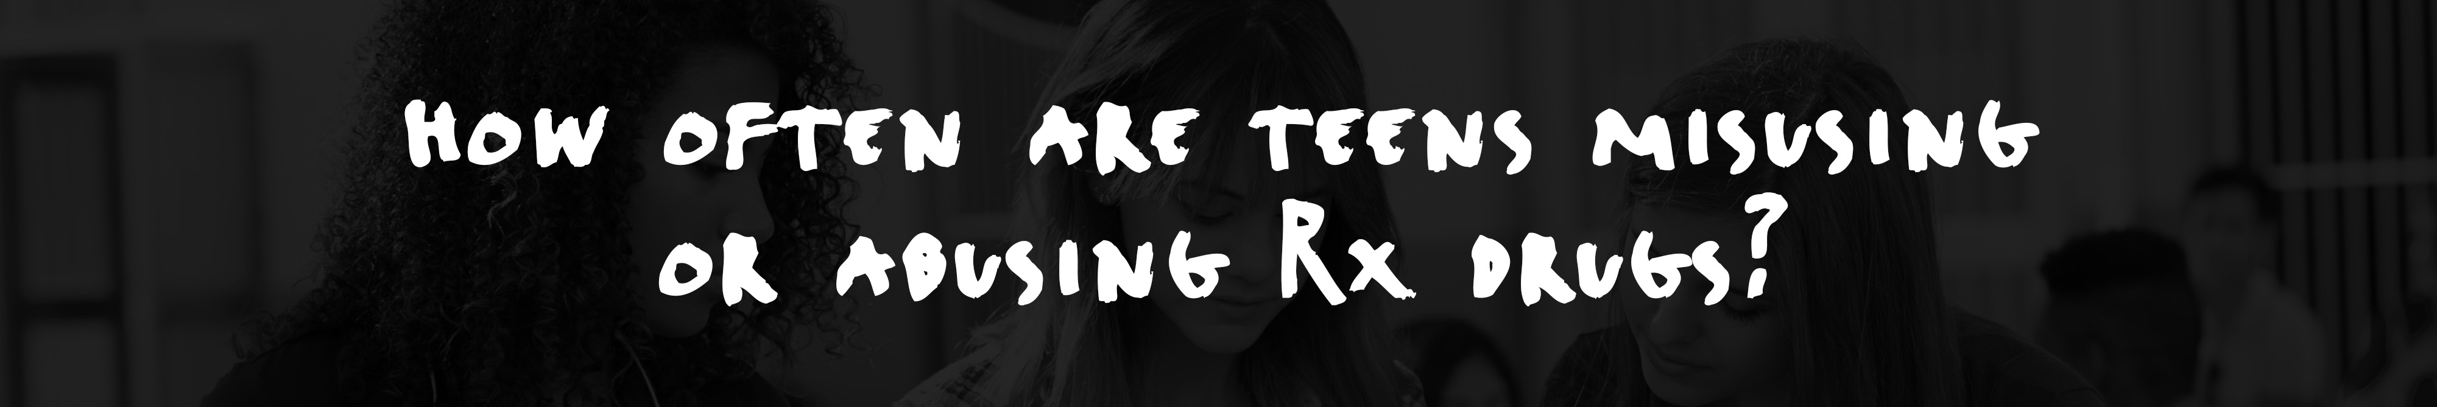
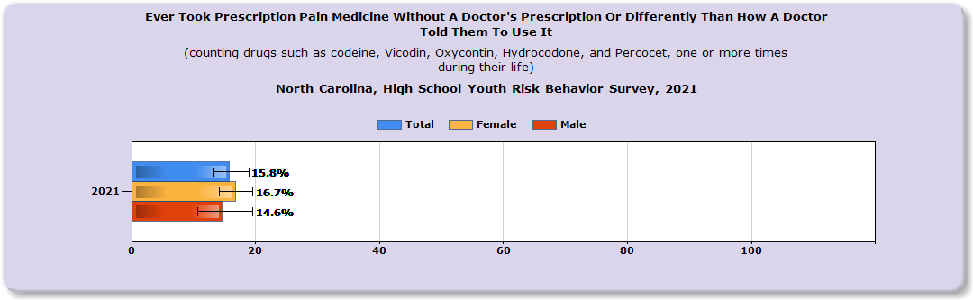
In 2021, 15% of NC high schoolers surveyed reported misusing or abusing prescription medication.
Source: NC Youth Risk Behavior Survey, 2021
NC Poison Control
Notes:
This data is from the North Carolina Youth Risk Behavior Survey.
15% of high school students report they have taken a prescription pain reliever without a doctor’s prescription or differently than a doctor told them to take it.

Slide 7

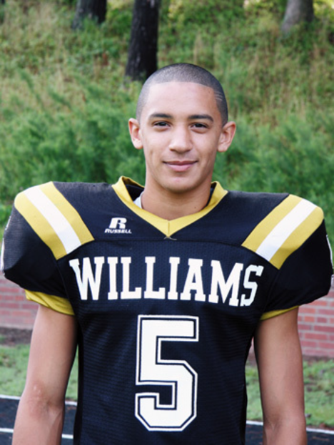
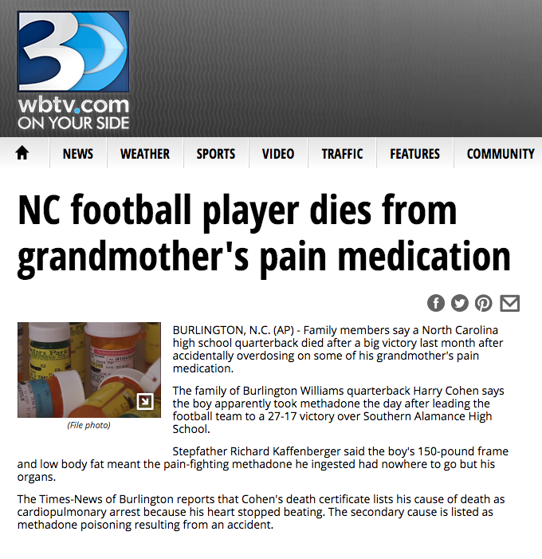
Harry Cohen
NC Poison Control
Notes:
A young North Carolina quarterback in Alamance County died after using his grandmother’s methadone to help recover after a football game. Methadone is a powerful opioid pain reliever.
When methadone is taken by the wrong person or in the wrong amount, it can slow down breathing, disrupt the way the heart works, and can cause death.¹
¹ “The Methadone Poisoning ‘Epidemic.’” The Forensic Examiner, Summer 2008.

Slide 8
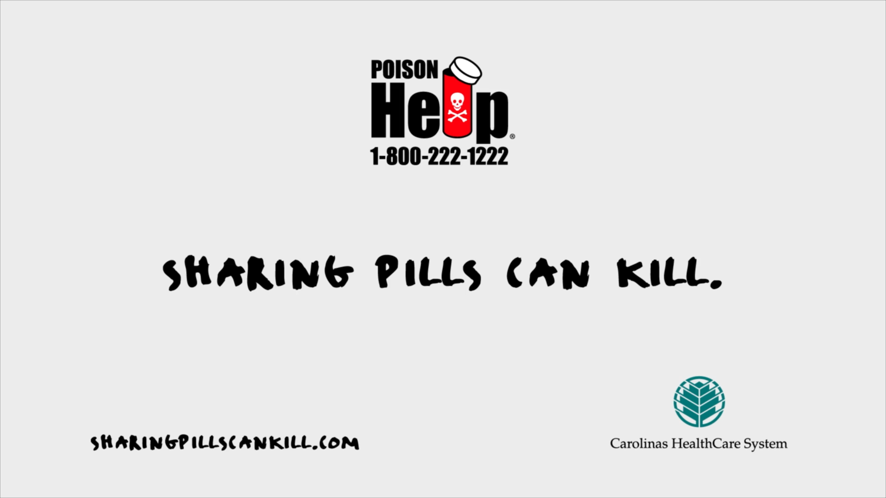
NC Poison Control
Notes:
Let’s watch this :30 video about sharing pills.

Slide 9
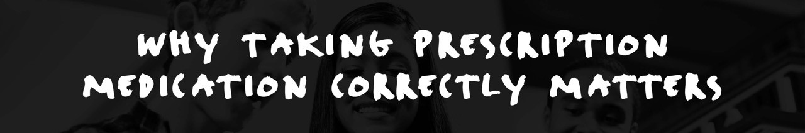

Taking too many prescription medications at one time or taking them with alcohol or other prescription medications can cause:
liver damage
brain damage
death
NC Poison Control
Notes:
Some teens—and adults— think that taking more of a prescribed medicine will make them feel better faster, but this is a myth.
Taking too many prescription pills, or taking them with alcohol, can cause liver or brain damage or death.

Slide 10
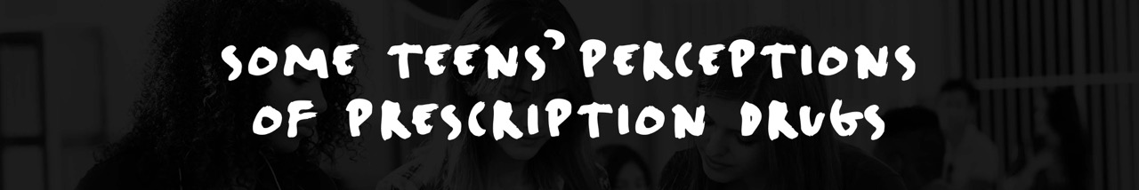

“I have mixed emotions about them. Some people have major pain, but some people abuse them.”
“If it’s prescribed by a doctor, it must
be safer.”
“I hear more about marijuana and alcohol than I do prescription drugs.”
“Kids at my school take Ambien® just to
mess themselves up.”
Source: NC Poison Control focus groups, 2012
NC Poison Control
Notes:
You may want to have different students in the class read each of the teen perceptions about Rx drugs and discuss whether they share those perceptions or feel differently about them.
After all of the perceptions are read, here are some follow up questions to consider asking:
When you think about “drug abuse,” what drugs initially come to mind?
Do you feel that parents are talking to their teens enough about prescription drug misuse?
Is enough being done to bring attention to prescription drug misuse and abuse?

Slide 11

“If it’s prescribed by a doctor, it must be safer.”
NC Poison Control
Notes:
What do you think? Do you think that because a medicine is prescribed that it’s safer than a street drug?
As we’ve discussed so far, a prescribed medicine can pose serious risk to a person when it’s taken in the wrong amount or by the wrong person.

Slide 12



Teens are being poisoned most often when they intentionally take the wrong amount of medicine or take someone else’s medicine…
to feel better faster
to get high
to hurt themselves
NC Poison Control
Notes:
Rx medication abuse is the most common reason for teen medication poison exposures.
Questions to promote discussion about abuse of prescription drugs:
Can you think of anyone in Hollywood or in the news who has abused a prescription drug? What happened?
Has someone you know ever incorrectly taken a prescription drug?
If so, why did they do it?

Slide 13
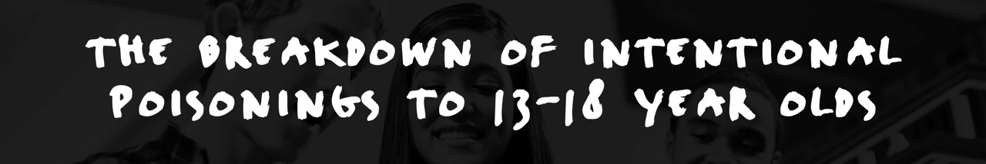
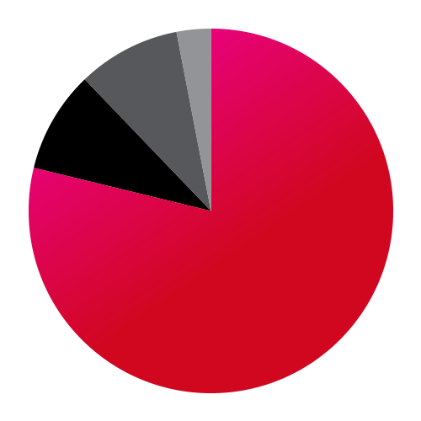
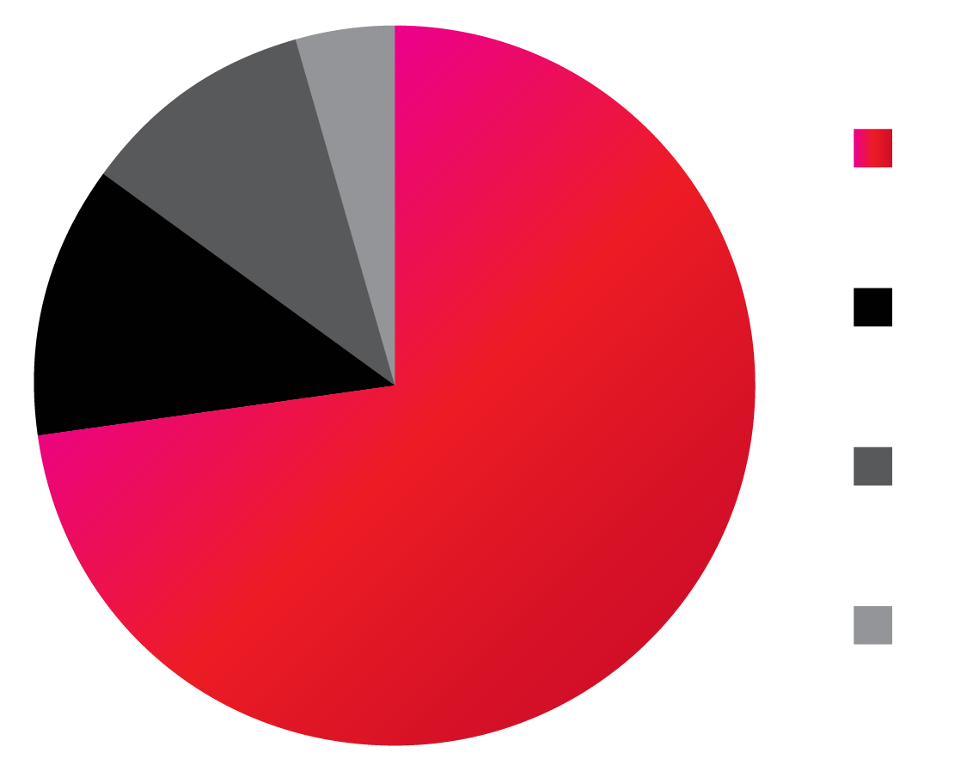
3%
8%
Suspected suicide/self-harm
8%
Intentional poisonings handled by NC Poison Control
8%
8%
Misuse
81%
Abuse
81%
Unknown
Source: NC Poison Control data, report run May 16, 2023
NC Poison Control
Notes:
Unfortunately, the majority of teens who incorrectly take medications are trying to harm themselves.
According to the Suicide and Crisis Lifeline, if someone is considering suicide, he or she might…¹
talk about wanting to die
talk about feeling hopeless or trapped
act anxious, show rage, or have extreme mood swings
behave recklessly
withdraw or isolate himself or herself
Noticing and acting on these warning signs can help prevent suicide. If you think someone might be considering suicide, tell a parent, school counselor, other trusted adult, or contact the Suicide and Crisis Lifeline at 988.
You may want to allow students the opportunity to save the Suicide and Crisis Lifeline number, 988, into their phones.
¹ for a more complete list of warning signs visit We Can All Prevent Suicide : Lifeline (988lifeline.org)

Slide 14
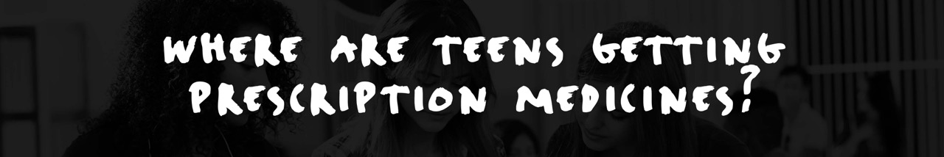
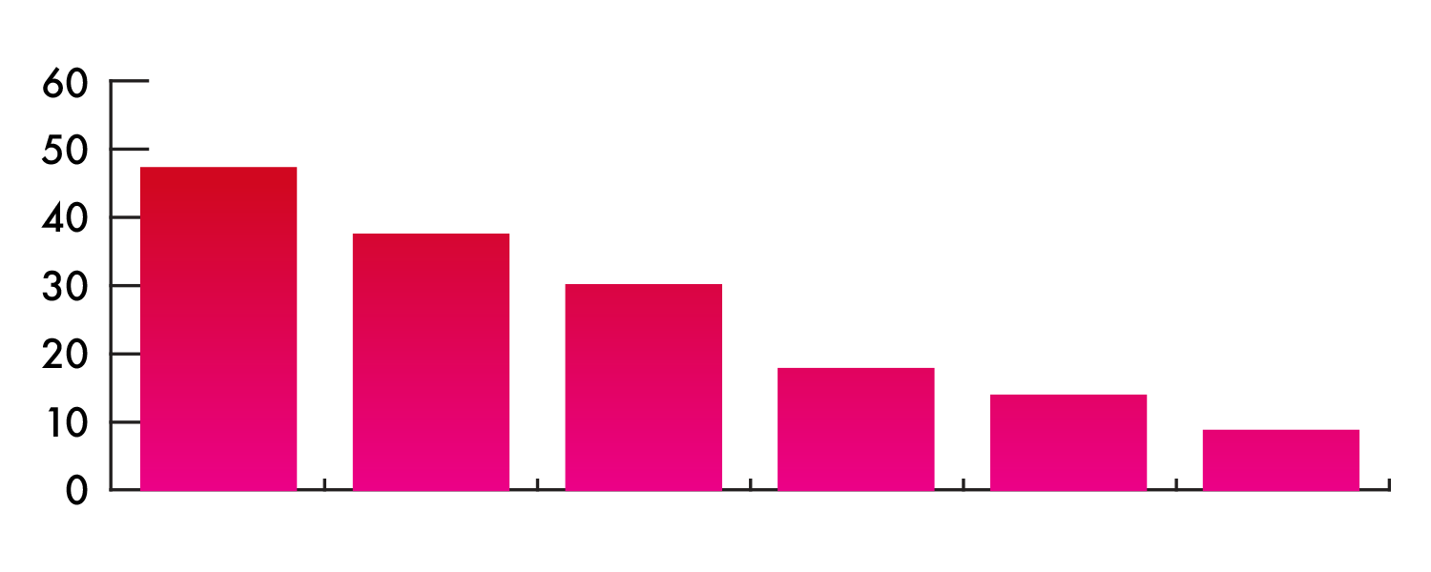
Source of Rx drugs among those who abused pain relievers in the past year, grade 12 (2019-2021).
47.4%
38.6%
30.1%
14.5%
12.2%
9%
Given by friend/relative
Bought from friend/relative
Prescription
Bought from stranger/dealer
Took from friend/relative
Internet
Source: University of Michigan, 2021 Monitoring the Future Study
Categories are not mutually exclusive
NC Poison Control
Notes:
High school seniors abusing prescription drugs said they most often got them from a friend or relative.
About one-third said they intentionally abused their own prescription, and nearly 10% bought prescription medication online.
Note: Prescription medications may have been obtained by more than one means.

Slide 15
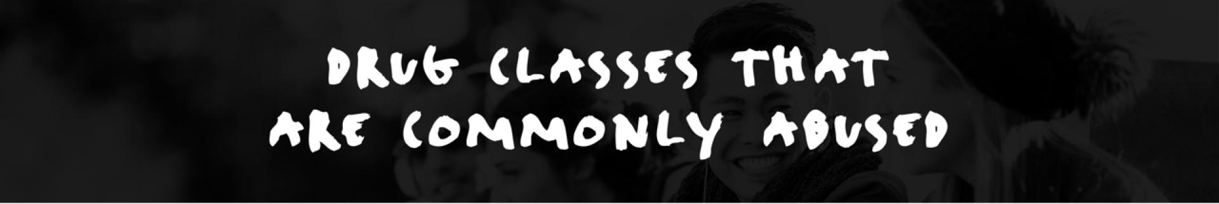
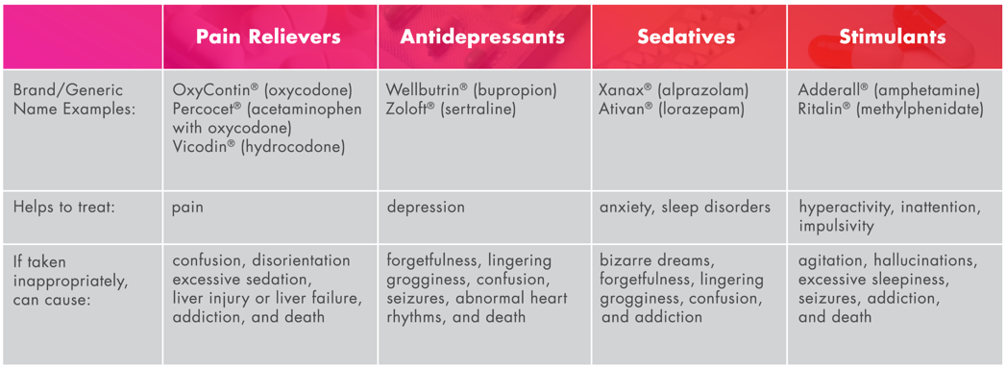
NC Poison Control
Notes:
In this slide, you’ll see some common prescription medications and why they’re prescribed. The generic name of the medicine is in parentheses; the brand name is capitalized.
You may have heard of some of these medications, or you may not be familiar with any on the list. It can help to know the name of these medications and the negative impacts that can occur if they are abused or misused.
Some common negative effects from misusing or abusing prescriptions can include:
confusion
grogginess
seizures
addiction
As we’ve discussed, death can also be an outcome of misusing or abusing Rx drugs.

Slide 16
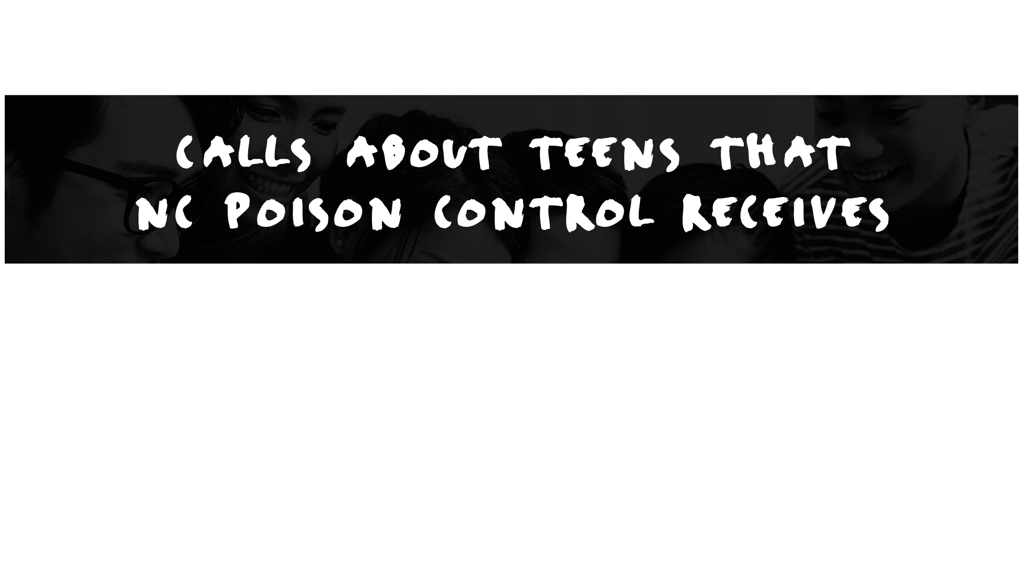
A 16-year-old who accidentally took two tablets of his ADHD medication instead of one tablet
A 17-year-old who combined prescription medicines by snorting Percocet® and taking Xanax® in an attempt to get high
A 15-year-old experiencing back pain who then took a parent’s muscle relaxer
A 14-year-old who took three dozen prescription pills
belonging to a parent in an attempt to hurt herself
NC Poison Control
Notes:
You may want to read aloud these medicine misuse and abuse scenarios to the class. They are actual calls that the poison control center has taken about teens.
Possible questions for further discussion:
How easy or hard do you think it is to confuse one medicine for another or to accidentally take the wrong amount of medicine?
On a scale of 1-5, with 1 being not harmful at all and 5 being very harmful, how harmful would it be to take someone else’s medicine?
On a scale of 1-5, with 1 being not comfortable at all and 5 being very comfortable, how comfortable would you be telling an adult if you noticed someone showing the warning signs of emotional distress that we talked about earlier?

Slide 17



Only take medicines that you are prescribed.
Take regularly prescribed medicine at the same time
each day, and store it in the same spot.
Don’t take more medicine than you’re prescribed. It won’t make symptoms disappear faster, and it could poison you.
Don’t mix pills with alcohol.
Don’t take medicines in an attempt to get high. Prescription medications taken inappropriately can kill you.
NC Poison Control
Notes:
You may want to choose different students to read each of these prevention tips.
Points to reinforce:
If you regularly take prescription medications, develop a routine about when and where you take them.
Taking a stronger dose of your own medication won’t make symptoms go away faster even though sometimes people think that more is better.
Remember: mixing alcohol with medications is dangerous! It can cause drowsiness, dizziness, increased risk for overdose, and increased risk for other serious injury like falls.¹
¹ Harmful Interactions: mixing alcohol with medicines. National Institute on Alcohol Abuse and Alcoholism, National Institute of Health, revised 2014.

Slide 18
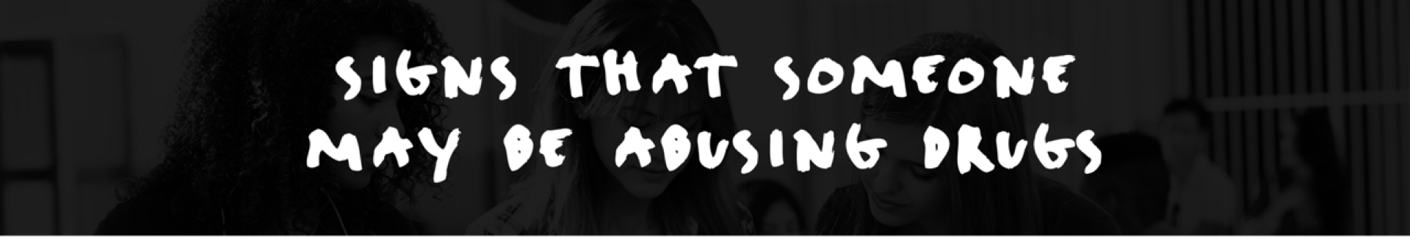


Frequently missing school
Sudden disinterest in school
Drop in grades or work performance
Neglected appearance
Lack of energy and motivation
Drastic changes in relationships with family or friends
Source: MayoClinic.org, accessed May 16, 2023
NC Poison Control
Notes:
These warning signs might mean that someone is abusing drugs. Remember that prescription drug abuse is drug abuse, too.
Contact a parent, school counselor, or other trusted adult if you are concerned for a friend or want to seek help for yourself.
Drug addiction (substance use disorder) - Symptoms and causes - Mayo Clinic

Slide 19
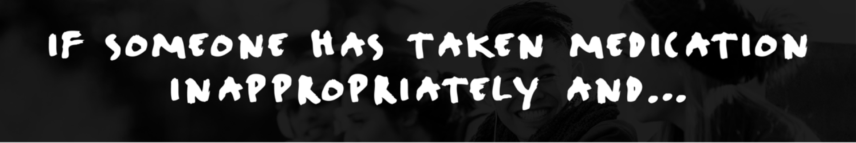
the person is unconscious or not breathing…
Call 911.
the person is conscious…
Call the poison control center at 1-800-222-1222.
or Live Chat at www.NCPoisonControl.org
NC Poison Control
Notes:
Knowing which first aid step to take in a medication mishap can help make sure a person gets the quickest and best help.
If the person is awake, call the poison control center to receive advice from a healthcare provider. Think of the poison control center as the 911 for poisonings.
If the person is unconscious, call 911 right away.

Slide 20
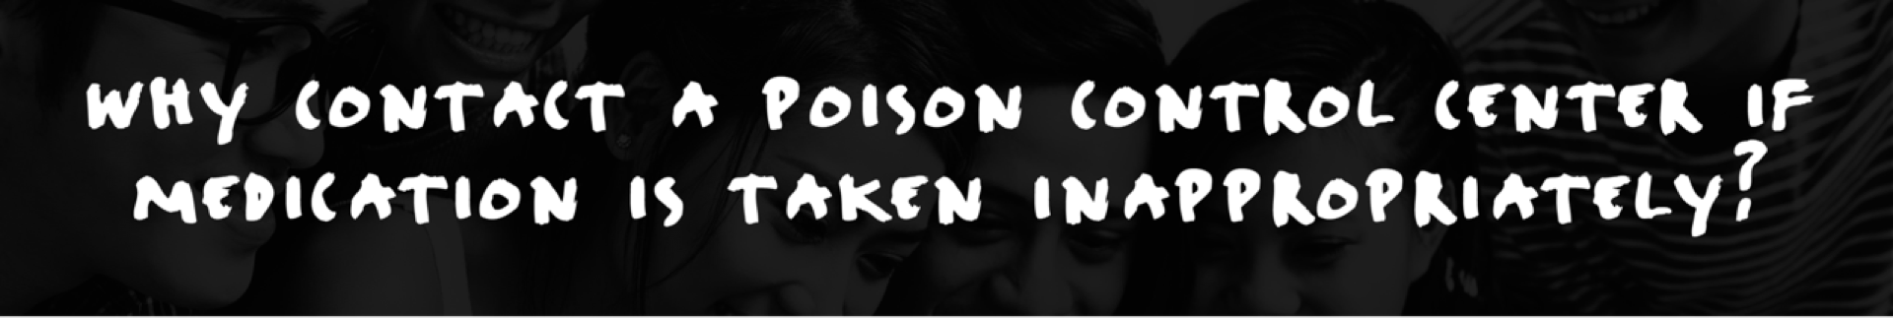

Nurses and pharmacists answer the phones or live chats. They can provide advice right where you are.
Calls and chats are confidential, just like a visit to
your doctor.
It’s free.
Other doctors and nurses call or live chat with poison control for help with their patients.
NC Poison Control
Notes:
People know and trust 911 as a universal emergency service.
While 911 dispatchers can get an ambulance to you, they cannot give you medical advice about your situation.
You may want to read aloud each of the 4 reasons listed.
Because nurses and pharmacists answer the calls and chats, they can let you know if the particular situation requires hospital care. Calls and chats are confidential.

Slide 21
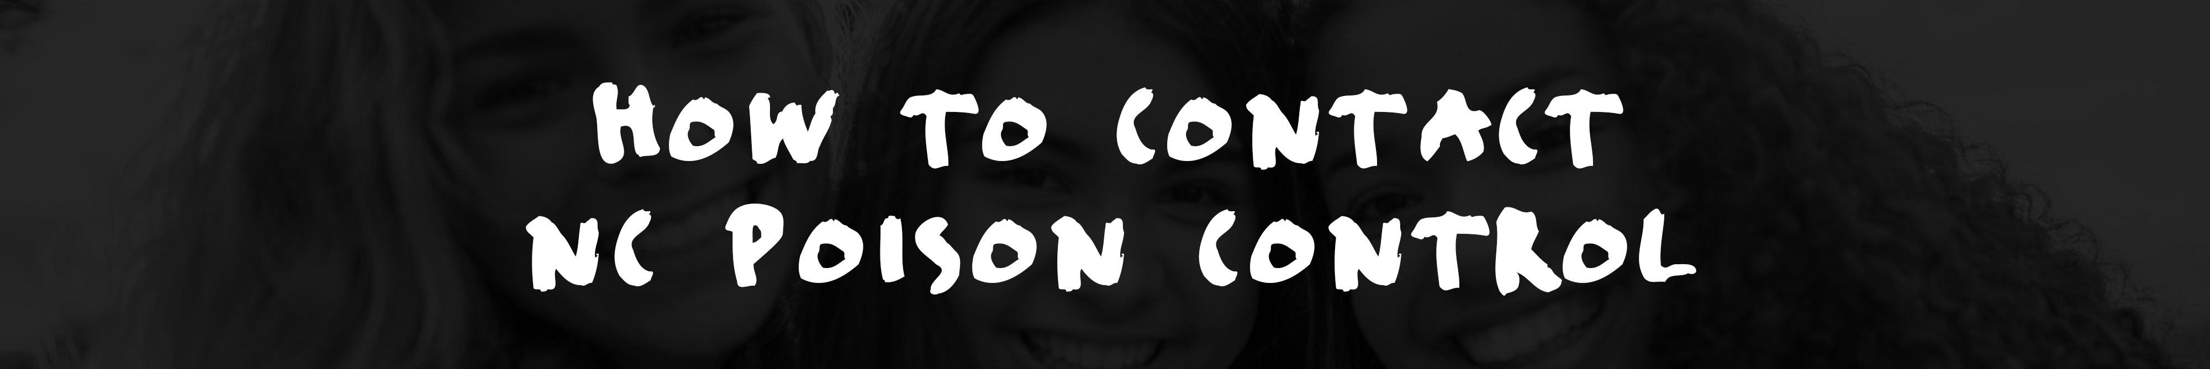

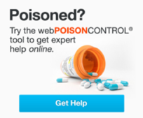

 | Call | Chat Now | Use webPOISONCONTROL®
 | 1-800-222-1222 | www.NCPoisonControl.org | www.webPOISONCONTROL.org
NC Poison Control
Notes:
There are 3 ways to contact NC Poison Control:
Phone (1-800-222-1222)
Live chat (www.NCPoisonControl.org)
Online triage (www.webPOISONCONTROL.org®)
Poison control is open around the clock, and the advice is free, no matter which method of contact is used.

Slide 22

STOP and add us into your phone
1-800-222-1222
NC Poison Control
Notes:
Encourage students to program the poison control number into their phones as they are viewing this slide.
Important to note: this number for poison control is the same number nationwide, so no matter where you go in the U.S., this number will connect you to the local poison control center serving you.

Slide 23
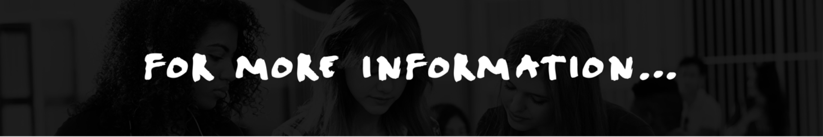
Visit www.SharingPillsCanKill.com
or
Call NC Poison Control at 1-800-222-1222
NC Poison Control
Notes:
You may want to take the opportunity to pull up www.SharingPillsCanKill.org with the class. The site has scrolling facts at the bottom that may be of interest.
It may also be a good time to explore www.NCPoisonControl.org to locate the chat feature or www.webPOISONCONTROL.org® to see how the online tool works. The site allows for trial users to input a practice scenario.

Slide 24
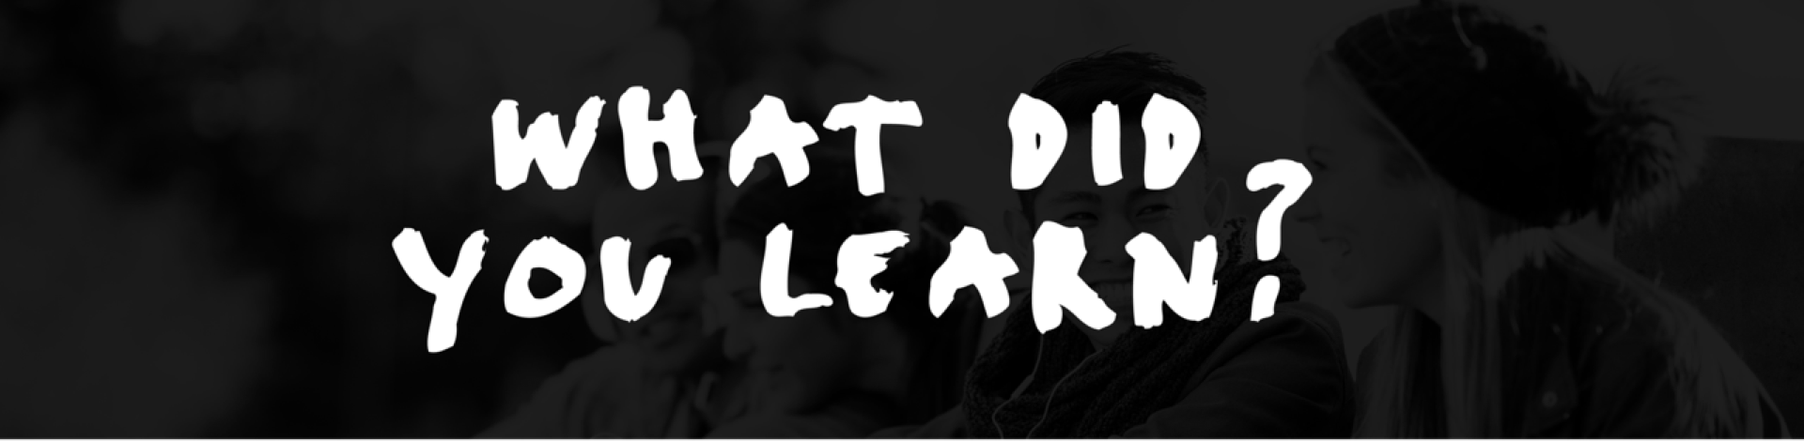
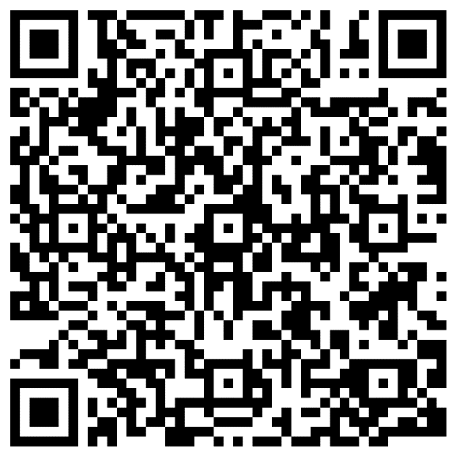
Take Survey
NC Poison Control
Notes:
The post-test is a 7-question survey. Scanning the QR code will direct students to the presentation post-test.
Answers to the post-test are below:
today’s date
when teens intentionally take the wrong medicine or wrong amount
10-20%
a friend or relative
true
subjective based on what the class retained
subjective based on whether phones and time were available to program the number
Thank you for encouraging post-test responses. Assessing what was learned helps us evaluate and improve education on this topic.
Thank you for administering “Preventing Teen Rx Medication Poisonings.”

